Slide 1
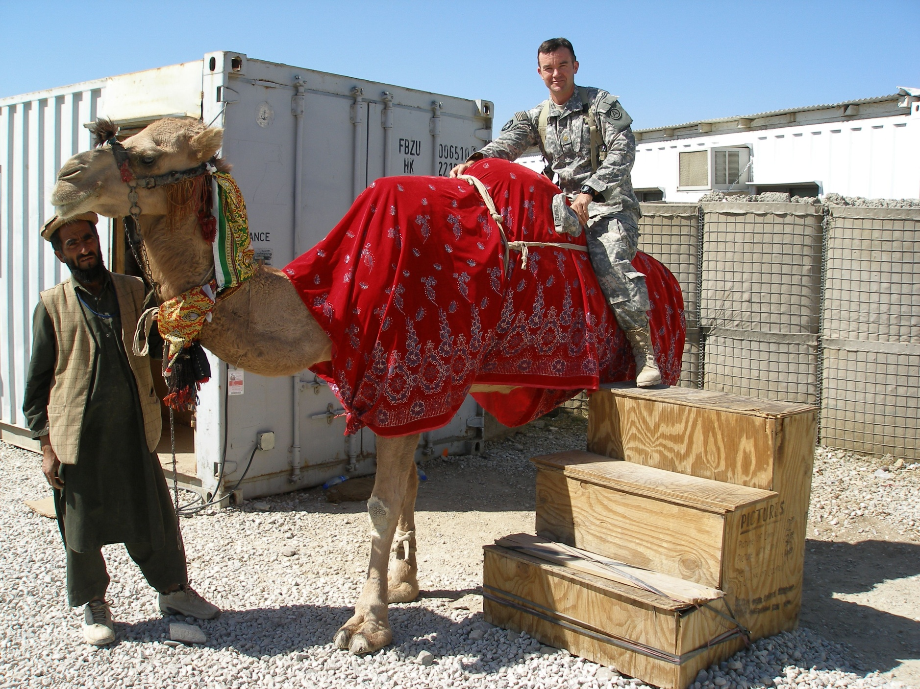

Slide 2
The Military Health System
“My little slice of the pie”
LTC Louis J. Schwartz
CPHIMS, FHIMSS

Slide 3


Agenda
How did I get here?
What I do in the Army
What the Military Health System encompasses
The area I'm currently working in
Some of my current projects
Where you can find more information
Questions

Slide 4
How Did I Get Here?
I wanted to serve my country from a very early age….Father said: “It’s the only profession left”
BA in History from The Citadel, 1991, commissioned as an Army officer the same year
Led medical units, supervising 26 to 140 individuals, for my first eight years in the military
Completed MS in Instructional Technology in 1997
Worked in fixed-medical units for the next eight years in the field of Health Information Systems
Currently a “consultant” to an executive physician responsible for managing Army Healthcare in Southwest Asia

Slide 5
What I do in the Army
The Health Services Systems Manager is responsible for the gamut of information technology operations and information policy across the Army Medical Department (AMEDD).
Known as 70 Deltas, or Deltas, Health Services Systems Managers can be found at most Army Medical Treatment Facilities (hospitals) and in all theaters of operation supported by the United States Army, including Iraq and Afghanistan.
Effective 70 Deltas acquire extensive knowledge of information-systems development, acquisition, deployment and maintenance.
Deltas become skilled at translating the needs of clinical personnel into real world systems that directly impact the health of the Army.
Deltas are intimately involved in the development of budgets, financial management and overall strategy for the commands in which he or she serves. The civilian equivalent of a 70D is a hospital chief information officer.

Slide 6
Who We Are and What We Do
TRICARE Facts and Figures
TRICARE Beneficiaries: 9.2 million*
TRICARE Prime Enrollees: 5.0 million
Direct Care Facilities:
• 65 Military Hospitals/Medical Centers
• 412 Medical Clinics
• 414 Dental Clinics
Military Health System Personnel: 132,700
• 46,300 Civilian
• 86,400 Military
FY06 Budget
Unified Medical Program: $39.32 billion
$28.16 billion
Defense Health Program
$11.16 billion
Medicare Eligible Retiree Accrual Fund
A Week in the Life
Inpatient Admissions: 19,600
• 5,000 Direct Care
• 14,600 Purchased Care
Outpatient Workload (Direct care only):
• 642,400 Professional Encounters
• 102,900 Dental Seatings
Prescriptions: 2.22 million
(Includes retail, direct care and mail order)
Births: 2,100
• 1,000 Direct Care
• 1,100 Purchased Care
Claims processed: 3.5 million
Weekly Bill: $754 million
*The number of beneficiaries eligible for DoD medical care fluctuates based on changes in retirees, active duty, Guard/Reserve, and their family members.

Slide 7
Army Specific
The Medical Command
The Medical Command includes our fixed medical facilities
37,102 clinic visits
361 patients admitted
1,308 patient beds occupied
28,863 dental procedures
5,420 immunizations
63 births
6,340 radiology procedures
81,984 pharmacy procedures
52,479 laboratory procedures
2,148 veterinary outpatient visits
$22.4 million-worth of food inspected
Deployed field units
57 beds occupied
19 dispositions (discharges, evacuations, etc.)

Slide 8
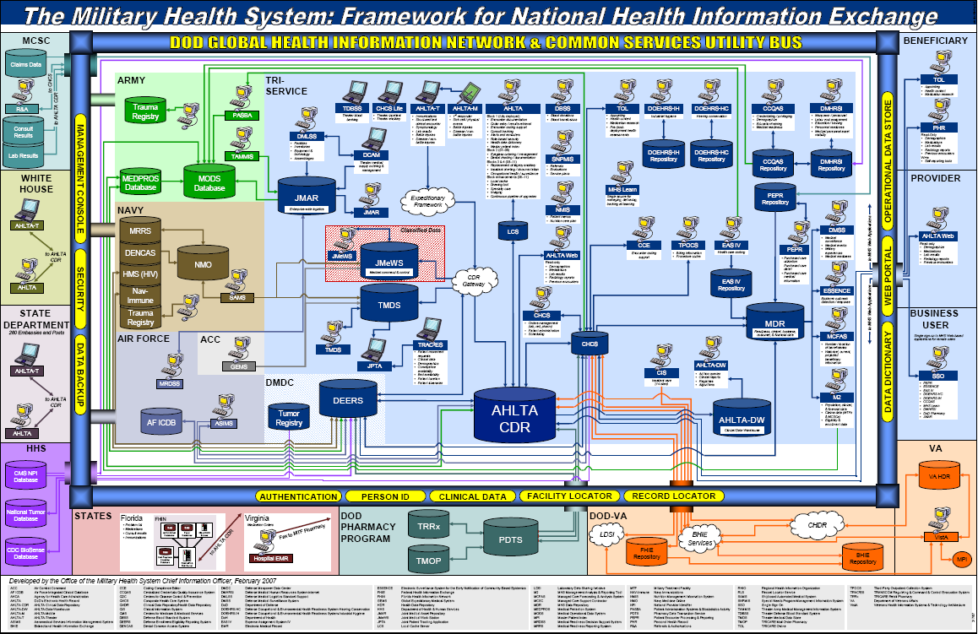
area I’m currently
working in
“Expeditionary Care”

Slide 9
MHS Expeditionary Applications
AHLTA ( - T) – Armed Forces Health Longitudinal Technology Application (Theater)
BMIST-J – (AHLTA Mobile) – Battlefield Information System Tactical - Joint
CDR – Clinical Data repository (Worldwide repository of all clinical data)
CHCS – Composite Health Care System.
DMLSS – Defense Medical Logistics Standard Support
JPTA – Joint Patient Tracking Application
JMEWSII – Joint Medical Work Station
MEDWEB – The Medweb Raq system is a small deployable Secure PACS, Teleradiology and Telemedicine system.
TMDS – Theater Medical Data Server
TC2 – TMIP CHCS Cache
ePDHA - stands for Electronic Post Deployment Health Assessment
TRAC2ES – TRANSCOM Regulating and Command and Control Evacuation System
TAMMIS – Theater Army Medical Management Information System.
TCAM/DCAM – TAMMIS Customer Assistance Module/DMLSS Customer Assistance Support

Slide 10
Feedback
No
New Requirement From Users
Help Desk System (TMIP CM)
TMIP TRIAGE & ICCB
Well Defined?
Yes
F
Req Type?
TFMO
Functional
T
IM SRWG
(Entered as a Submission in DOORS)
Feedback
Theater Issues
No
TMIP PMO
TFWG
Technical
Theater CCB
No
Within Cost and Sched?
Yes
Validated?
Yes
Technical & Functional Detailed Requirements
Prioritized
Yes
PEO/CIO Review
FHPC
Yes
TMIP PM for Execution
Approved?
Feedback
No
Entered In DOORS
All organizations feedback decisions to TMIP CM to keep TeamTrack documentation updated.

Slide 11
Things I’m Working On
Fielding a Health Information System to the Peace Keeping mission in the Sinai
Usability and usefulness of current suite of HIS in use for Expeditionary Care
  Focus groups and web-based survey
Advocate for education and governance for the HIS used in our clinical business processes

Slide 12



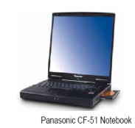




AHLTA
in MHS facilities registered users
can see outpatient encounters
that occurred prior to deployment
In addition to all past encounters
Seen at an MTF
TMDS
Web based
Patient history
Review. Website
providers
can “see” past
encounters
that only
occurred
In theatre
CDR
The only record
of care
LEVEL V
AHLTA-Warrior
view only of AHLTA
Used by providers to see past history
That occurred outside theater
username
password
In-patient care
username
Internet
SHARE
VA web product
read only view of AHLTA
password
LEVEL IV
AHLTA-Mobile
Software program
On hand held
MUST sync to
A CHCSIIT
computer to move
encounter/data
forward
AHLTA-T
Client Server
ambulatory
encounter
system
captures
out-patient
Visits.
MEDWEB
Web based
program
which allows
providers to
review
X-rays
digitally
CHCS – TC2
Client Server
program used by
providers for
Inpatient
documentation and
to order rads, labs,
and pharmacy. Sends
Inpatient and ancillary
Data to TMDS and
JMEWS to be
viewed
JPTA
Web based patient tracking
program. Required for patient transfer inter and intra
theatre visibility. PAD personnel will require uploading narrative summary of patients to be transferred, as well as providers
wanting to follow status of patients. The system is also
being used as an In-patient
documentation system but that
patient
username
password
LEVEL III
username
username
LEVEL II
password
password
username
Only Level II+ and III
facilities have
CHCS
username
Out-patient care
password
password
username
username
LEVEL I
password
password
JMEWSII – web based – Required for C2, Force health protection tracking, blood management, bed status, and reporting Annex Q
TRAC2ES – Used by PAD to request patient transfers with USAF – web based
TAMMIS/DMLSS/TCAM/DCAM –medical logistics management systems –client/server/web based
MODS - Used to track and input human resources information: personnel, training, ARNG medical readiness status
MEDPROS - Track and input medical readiness information; immunizations – web based
ePDHA – Electronic Post Deployment Health Assessments – web based
Micromedex - Software program on MC4 laptop used to do medical Research

Slide 13
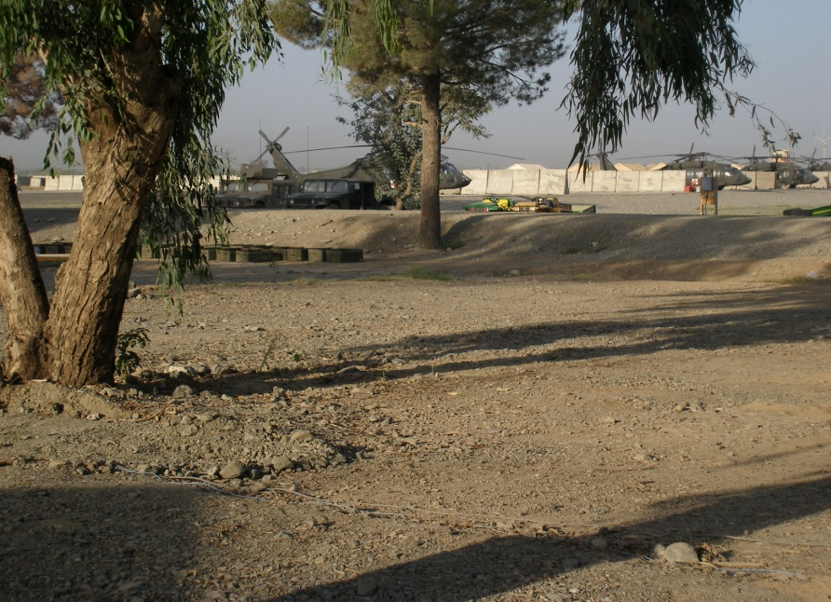
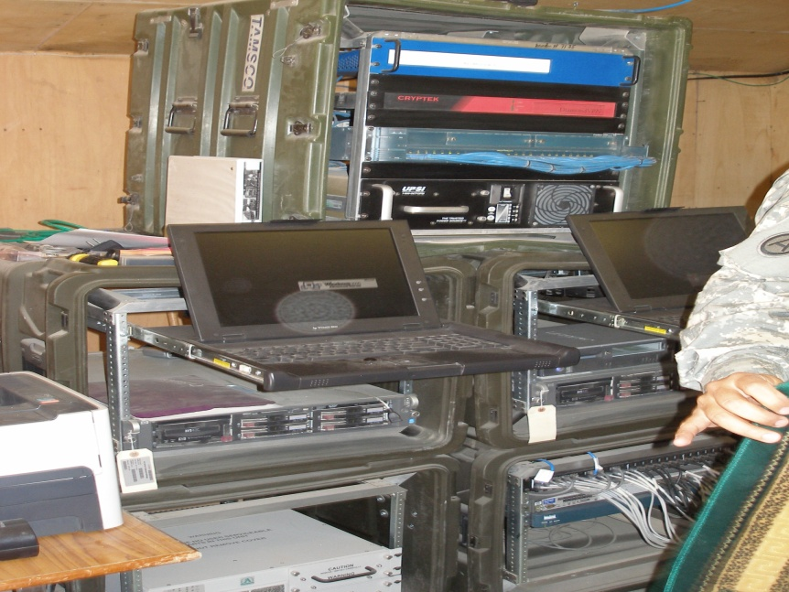
What it looks like

Slide 14
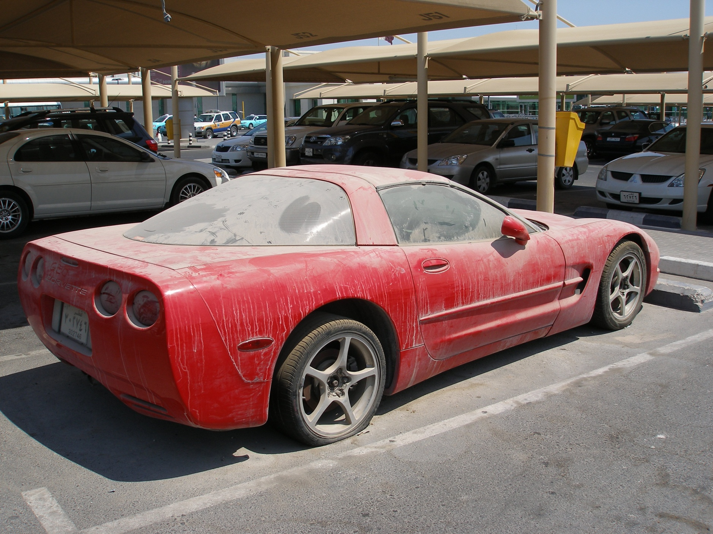

Slide 15


Slide 16
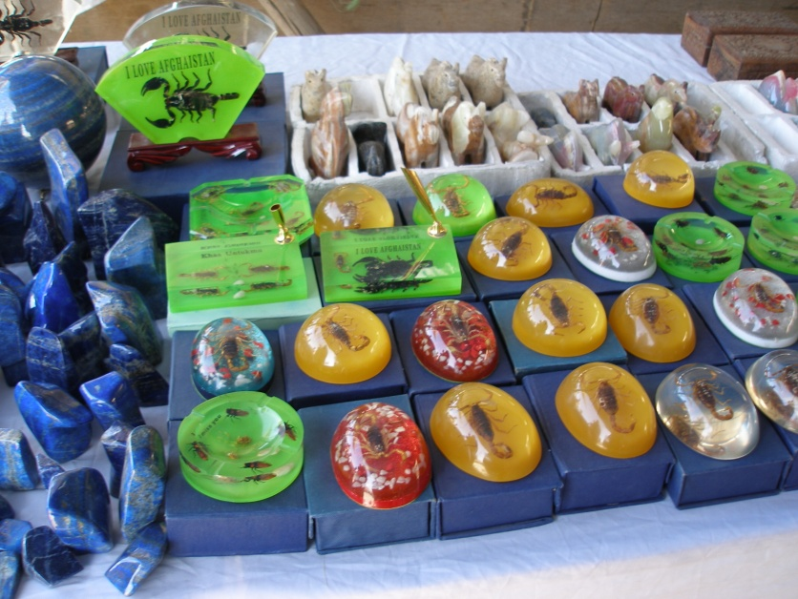
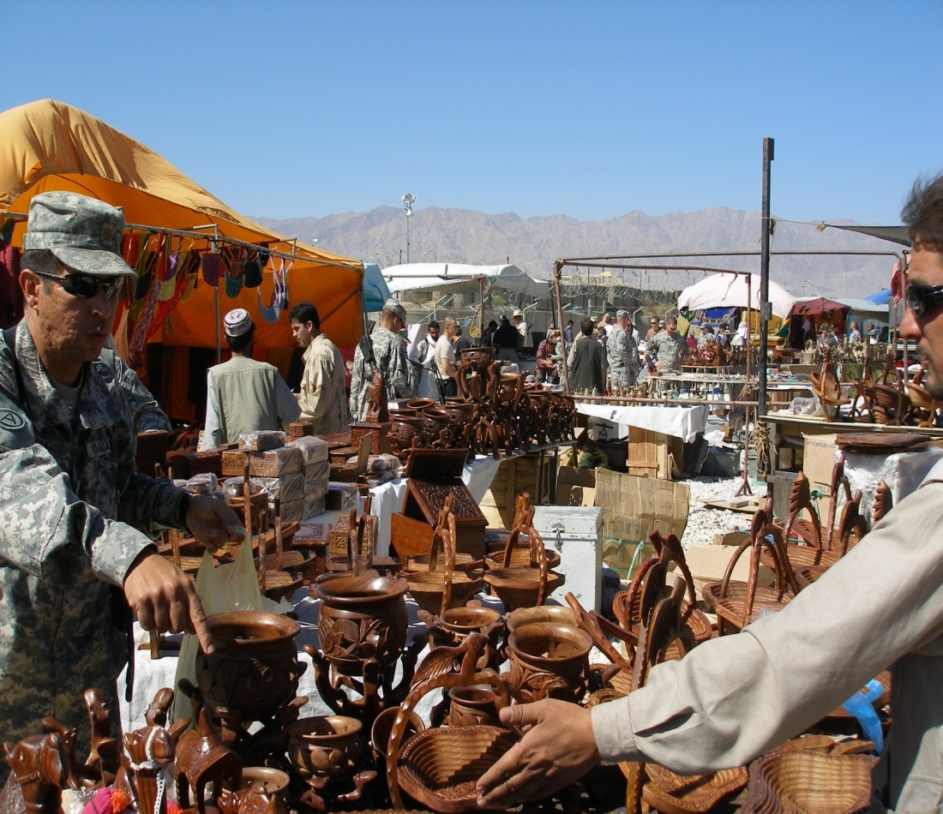
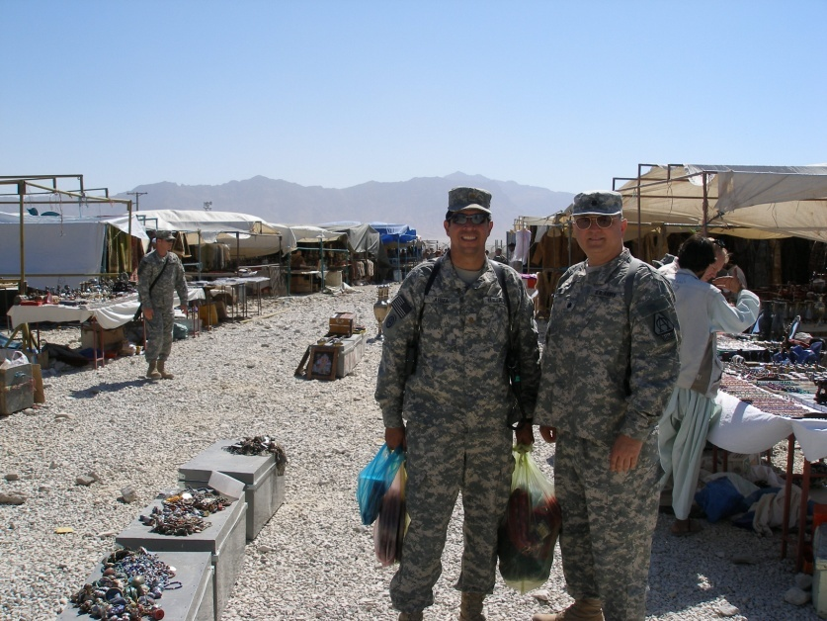
Shopping in Afghanistan

Slide 17
More Information
DOD Health information
Expeditionary Health Info Sys
My career field in the Army
Adopting pets

Slide 18


Questions

